Slide 1

Implementation of Augmented Reality and Virtual Reality in Different Fields
Presented By: Deepankar Sharma
(BCA IV),
Graphic Era Hill University

Slide 2

1 Artificial Intelligence (AI)
2 Computer Vision
KEYWORDS
3 Virtual Reality (VR)
4 Augmented Reality (AR)

Slide 3
Artificial Intelligence
Machines are Intelligent, Can make decisions
Tremendous amount of power the data holds
Computer Vision
Domain of AI -----> visual inferences from digital images, videos, etc
Virtual Reality
Sophisticated to replace the original real environment with an artificial environment
Augmented Reality
This artificial environment is augmented with read environment ----> parallel

Slide 4



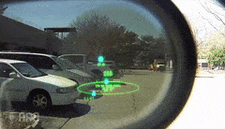
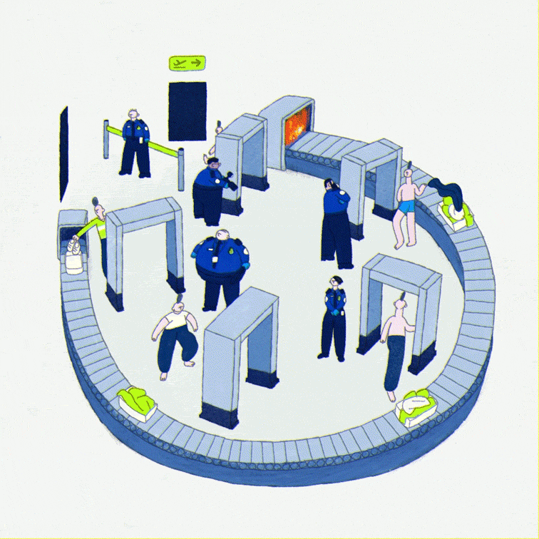
Applications of Augmented Reality and Virtual Reality
Public Safety
Public Safety

Slide 5
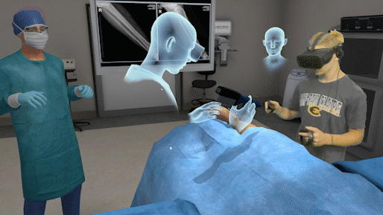
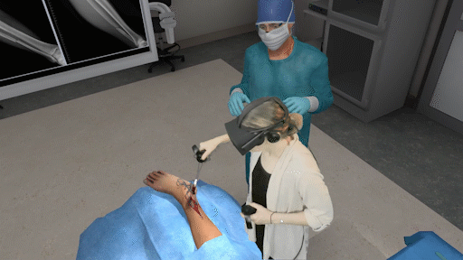
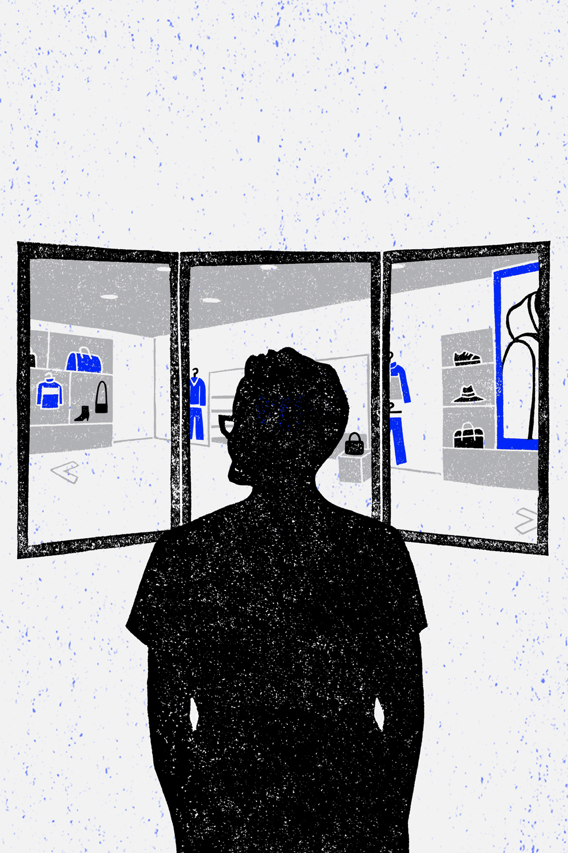
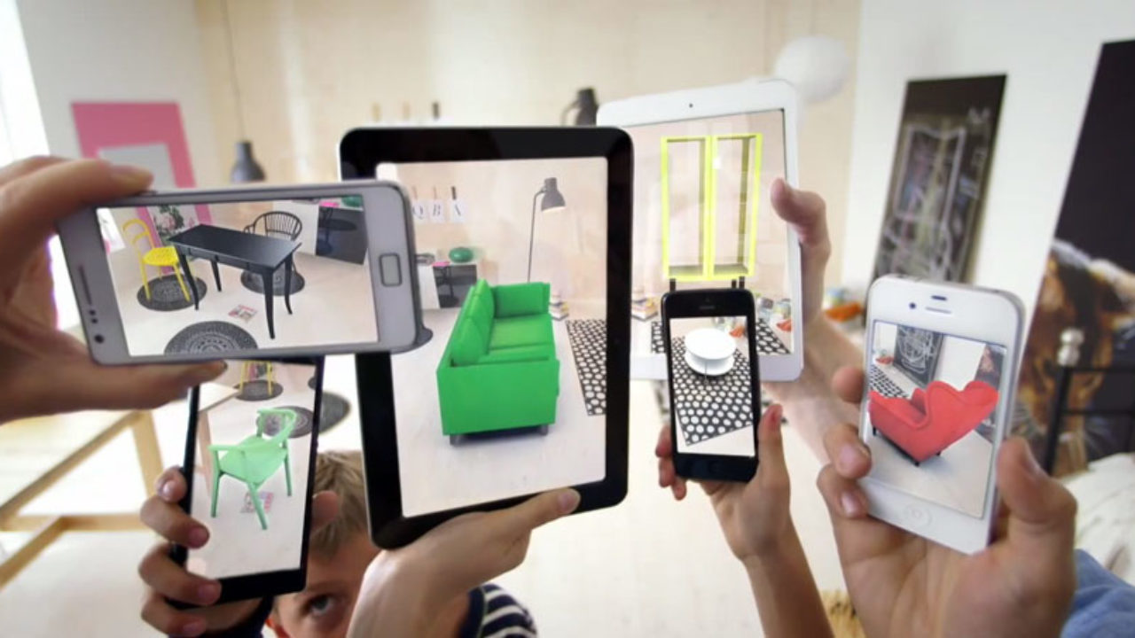


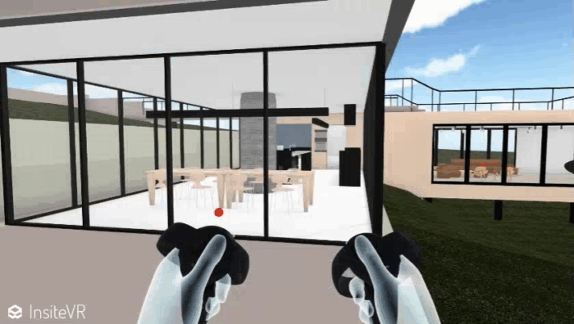
Medical Training
Retail
Design and Modelling

Slide 6
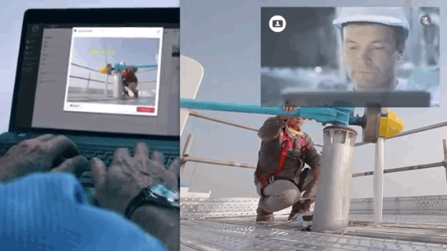
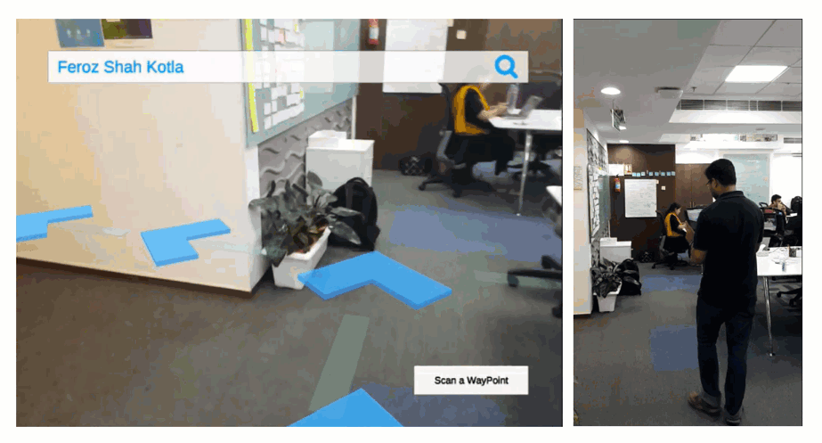
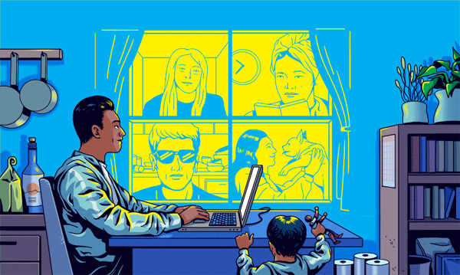


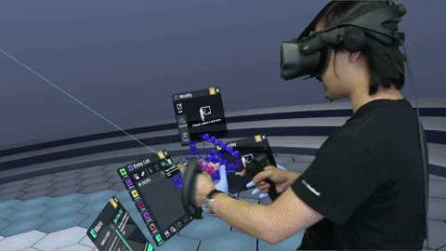
Repair and Maintenance
Business Logistics
Classroom Education

Slide 7
Potential Threats by AR and VR
AR could (further) privatize public spaces
Autonomous Driving

Slide 8
AR threatens our rights
Reality Distortion
Classroom Education

Slide 9
Feedback
?

Slide 10
THANK YOU

